Slide 1
Title: CMCS Claims System - Part 3
Presented by: Mukhethwa Murivhula
Date: 21 November 2025

Slide 2
From Part 2 to Part 3, I improved the system by adding user login, roles, and stronger security with sessions. I introduced an HR Super User role and connected the app to a Microsoft SQL Management System database using Entity Framework Core. User profiles now load automatically, and the system can generate reports. I also added proper role-based access to control what each user can do.
The project uses ASP.NET Core MVC, EF Core, SQL , session management, Bootstrap 5, and file encryption.

Slide 3
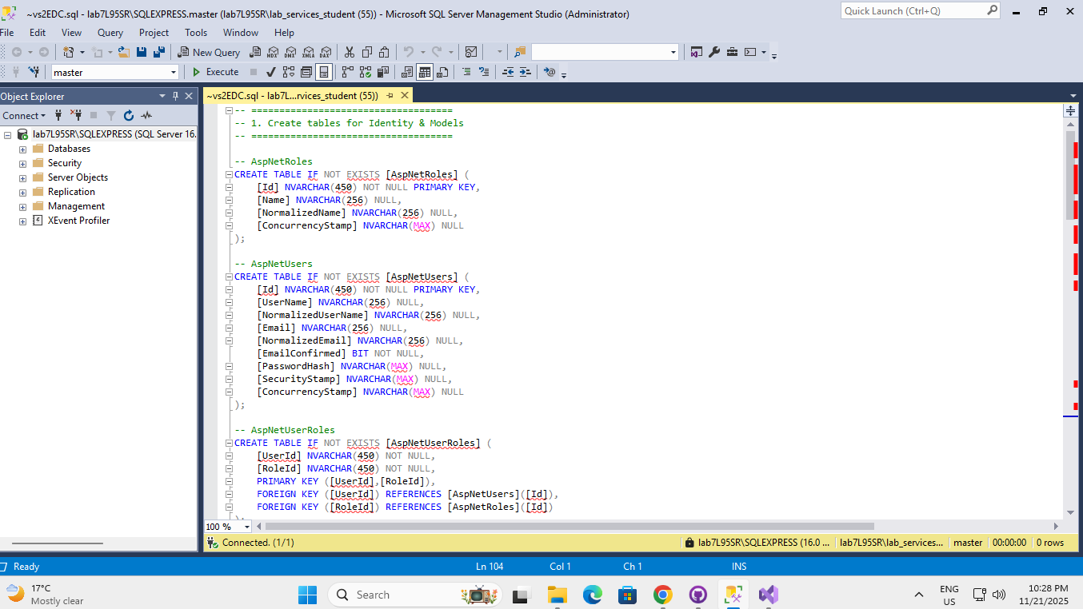

Slide 4
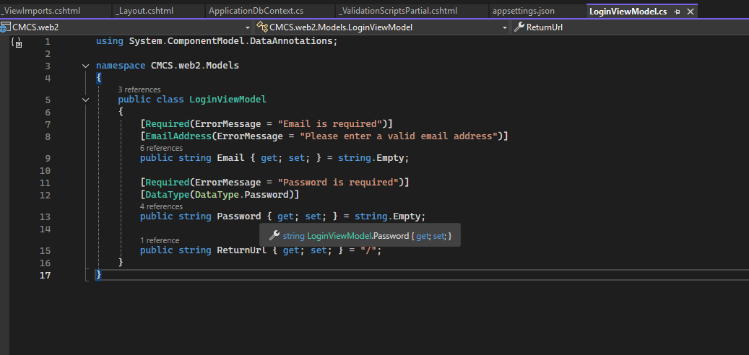
Snippet of my Login View Model

Slide 5
Slide 6: Lecturer View Enhancements
Before (Part 2):
Manual input of email and hourly rate
No user validation
Basic claim submission
After (Part 3):
csharp
// Auto-populated from user profile
var model = new ClaimCreateViewModel
{
LecturerEmail = user.Email,
LecturerName = $"{user.Name} {user.Surname}",
HourlyRate = user.HourlyRate // From HR setting
};
New Features:
Auto-calculation with user's hourly rate
Monthly validation (180 hours max)
Secure document upload
Real-time claim tracking

